Slide 1
PortLand: A Scalable Fault-Tolerant Layer 2 Data Center Network Fabric
Radhika Niranjan Mysore, Andreas Pamboris, Nathan Farrington, Nelson Huang, Pardis Miri,
Sivasankar Radhakrishnan, Vikram Subramanya, and Amin Vahdat
Department of Computer Science and Engineering
University of California San Diego
Presented by:
Ting wang
2013-02-25

Slide 2
OUTLINE
Issues of Centralized Fabric Manager
Convergence time for TCP
How good is the performance of PortLand?
Switch issues
Cost-effectiveness
Traffic Congestion Issue

Slide 3
Issues of Centralized Fabric Manager
The FM can become the bottleneck since all the functionalities rely on it;
the paper discusses several fault scenarios, it pretty much avoids discussion on FM failure saying that the FM is distributed and replicated, hence robust. Some qualitative evaluation of FM failure could provide important insight into PortLand’s fault tolerance. The evaluation section in general is not very strong. The authors could have evaluated the overheads of changing PMAC addresses, the affect of multiple VM migrations simultaneously among others.
If the communication with the fabric manager is congested or the fabric manager crashes, the performance will be greatly degraded;

Slide 4
Issues of Centralized Fabric Manager
If the deployed scale of a data center is too large, the number of servers used as fabric manager should dramatically increase, which is very costly and also hard to manage;
The FM is a server, and the paper didn’t describe how to communicate between switches and FMs, i.e, how could the switches know the existence of the fabric manager(s)?
The communication between the switches and the fabric manager is too frequent, which increases the network loads besides the normal data transfer. (FM monitors connectivity with each switch module and reacts to the liveness information by updating its fault matrix. Switches also send keepalives to their immediate neighbors every 10ms)

Slide 5
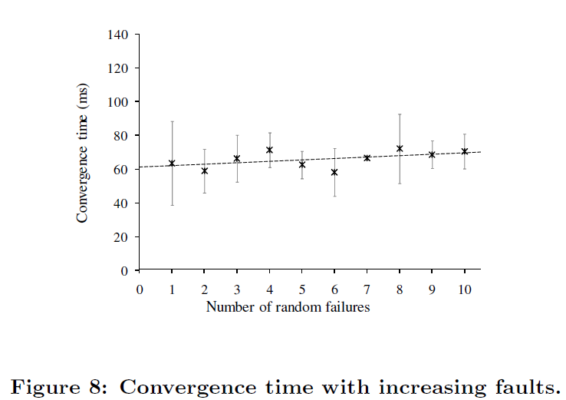
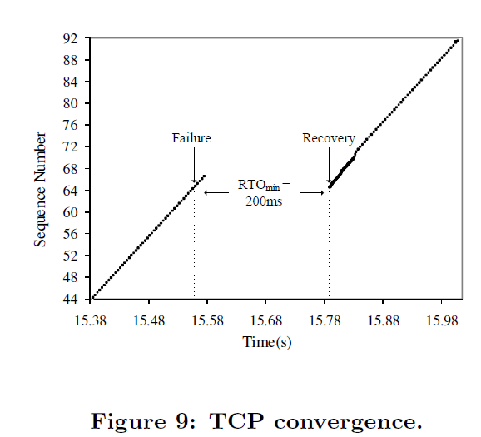
Convergence time of TCP
The paper claimed that the convergence time of the UDP flows is about 65 ms and that for TCP flows is much longer. However, 99.91% of traffic in a typical data center is TCP traffic[1].
How to reduce the convergence time of TCP flows?

Slide 6
How good does the PortLand perform?
The paper only states PortLand is a viable solution for DCs; however, in the evaluation section there is no quantitative comparison against any other DCN architectures in terms of the performance, cost and management complexity.
Without any type of baseline to compare against, it’s hard to say how good PortLand performs.

Slide 7
Switch Issues
The switches should be modified to meet the system requirements. This is not easy to be popularized.

Slide 8
Cost-effectiveness
PortLand applies FatTree topology which has a good performance in bandwidth, load balancing, and fault-tolerance, however, there are lots of redundant links/switches which will increase the expenditure of DC.

Slide 9
Traffic Congestion Issue
In the case of multicast or high traffic volume, how to handle traffic congestion? This is not taken into consideration…

Slide 10
Referrences
[1] M. Alizadeh, A. G. Greenberg, D. A. Maltz, J. Padhye, P. Patel, B. Prabhakar, S. Sengupta, and M. Sridharan. Data center TCP (DCTCP). In Proc. SIGCOMM, 2010.

